Slide 1
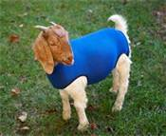
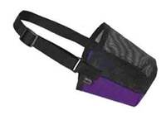
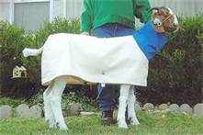
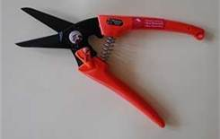
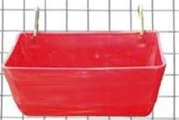
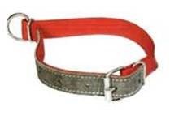
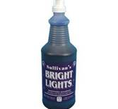
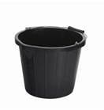
What Equipment Do I Need for my GOAT?
Drench Gun
Goat sock or stretchy tube
Muzzle
Goat Blanket
Hoof Trimmers
Show Chain
Collar
Hanging Feed Bucket
Water Bucket
Pink Hair Conditioner – This needs to be aerosol
Whitening Shampoo

Slide 2
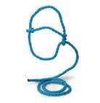
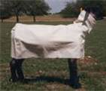
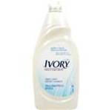
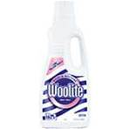
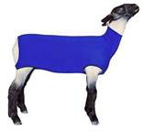
What Equipment Do I Need for my Lamb?
Drench Gun
Lamb Blanket
Muzzle
Hanging Feed Bucket
Lamb Halter
Woolite – To help Whiten Wool
Water Bucket
Dish Soap for Shampoo – And brand will do
Pink Hair Conditioner – This needs to be aerosol
Lamb Sock or Stretchy Tube

Slide 3
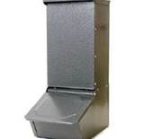
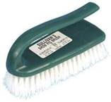
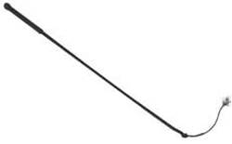
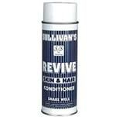
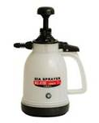
What Equipment Do I Need for my Pig?
Pig Self Feeder
Pig Brush
Pig Feeder
Pig Whip
Hair Conditioner – Sullivan’s Revive is good but any brand will work
Whitening Shampoo
Pig Waterer

Slide 4
How Do I Feed My Goat?
Goats should be fed a high quality show feed – I recommend Surefed or Showrite
Goats need clean water every day – if you wouldn’t drink it neither should they
Goats need hay in order to keep their rumen going
A handful of coastal and alfalfa 3 times a week (given together)
Goats should eat 3% of the their body weight, as they grow increase your feed. Weigh your animal and your feed regularly. Different feeds have a different weights.
Give 2 cc (up to 50 lbs weight) B complex every week either down the throat or under the armpit…you will increase by 0.5 cc every 15 lbs.
Goats need to be dewormed every 28-30 days
Alternate your dewormer (ACTIVE INGREDIENT) every month
3 days in a row- 150 lb dose of Safegaurd every other 30 days
Every other 30 days- Zimectrin gold, or Equimax (125 lb dose)
60 days until show
Add protein (make sure you feed a protein that works with your feed…meaning they come from the same company or feed grandgoat)
30 days until show
Add Barley to Feed (1:4 ratio)
Add Grand Goat (3-4 ounces)

Slide 5
How Do I Exercise My Goat?
For the first 2 weeks, hand feed your goat and get them used to you, DO NOT TAKE THEM OUT OF THEIR PEN
First several months
Allow the goat to get out and run by themselves
Do not push them – just let them get some exercise
Start practicing walking and bracing as if you are showing them (a mirror is the best way for you to see what you are doing wrong)
60 days until show
Run 3-4 times per week for 10-15 minutes (once the goat starts breathing hard stop)
Once per week pull weights or walk up hills (10-15 pounds)
45 days until show
Increase number of days that the goat pulls weights, increase weight as it gets easier for the goat to pull
Increase the days that the goat runs
30 days until show
Increase weights
Goat should be running and pulling weights a combined amount of 20 minutes per day, 5-6 days a week
Always give your goat a day off

Slide 6
How Do I Feed My Lamb?
Sheep should be fed a high quality show feed – I recommend Surefed or Showrite
Sheep need clean water every day – if you wouldn’t drink it neither should they
Sheep need hay in order to keep their rumen going
A handful of coastal and alfalfa 3 times a week (given together)
Sheep should eat 3% of the their body weight, as they grow increase your feed. Weigh your animal and your feed regularly. Different feeds have a different weights.
Give 2 cc (up to 50 lbs weight) B complex every week either down the throat or under the armpit…you will increase by 0.5 cc every 15 lbs.
Sheep need to be dewormed every 28-30 days
Alternate your dewormer (ACTIVE INGREDIENT) every month
3 days in a row- 150 lb dose of Safegaurd every other 30 days
Every other 30 days- Zimectrin gold, or Equimax (125 lb dose)
60 days until show
Add protein (make sure you feed a protein that works with your feed…meaning they come from the same company or feed grandgoat)
30 days until show
Add Barley to Feed (1:4 ratio)
Add Grand Goat (3-4 ounces

Slide 7
How Do I Exercise My Lamb?
For the first 2 weeks, hand feed your lamb and get them used to you, DO NOT TAKE THEM OUT OF THEIR PEN
First month
Allow the lamb to get out and run by themselves
Do not push them – just let them get some exercise
Start practicing walking and bracing as if you are showing them (a mirror is the best way for you to see what you are doing wrong)
After the first month
RUN, RUN, RUN
A treadmill is the best way to run a lamb
Also walk on tall ramps or hills
Pull weights
Always give them at least 1 day off

Slide 8
How Do I Feed My Pig?
Start with a 16-20% protein feed– Suggestion: Purina Honors, Linders, Moormans
Remember whatever brand you use…use the same brand supplements
Add 3.5%-6.5% fat
Feed a full feeder until about 150 pounds
Pigs need clean water every day – if you wouldn’t drink it neither should they
After pigs reach 180 pounds start making feed into a slurry (wet and make slightly sloppy)
Need Fat:
Linders Slop or Moorfat
Drench with wheat germ oil – 3 ounces per day
Need Muscle:
Paylean – feed one tablespoon of baking soda with this

Slide 9
How Do I Exercise My Pig?
For the first 2 weeks, hand feed your pig and get them used to you. DO NOT TAKE THEM OUT OF THEIR PEN
After 2 week start walking them for 15-20 minutes every day (twice on the weekends)
Make sure you are walking with their heads help up – use the pig whip lightly under their head
Use the pig whip to control which way your pig walks

